Slide 1


FITFLEX – GYM CLASS SCHEDULER
By
Pallavi Sarovar

Slide 2


Index
1. Problem Statement
2. Solution
3. Working (Method / System Flow)
4. Conclusion

Slide 3
Problem Statement
Fitness studios require an efficient system to manage
class schedules and bookings.
Manual booking systems can cause:
• Difficulty tracking available spots
• Inefficient scheduling
• Lack of real-time updates
The goal is to create a digital system that allows
users to view schedules, filter classes, and book
fitness sessions easily.

Slide 4
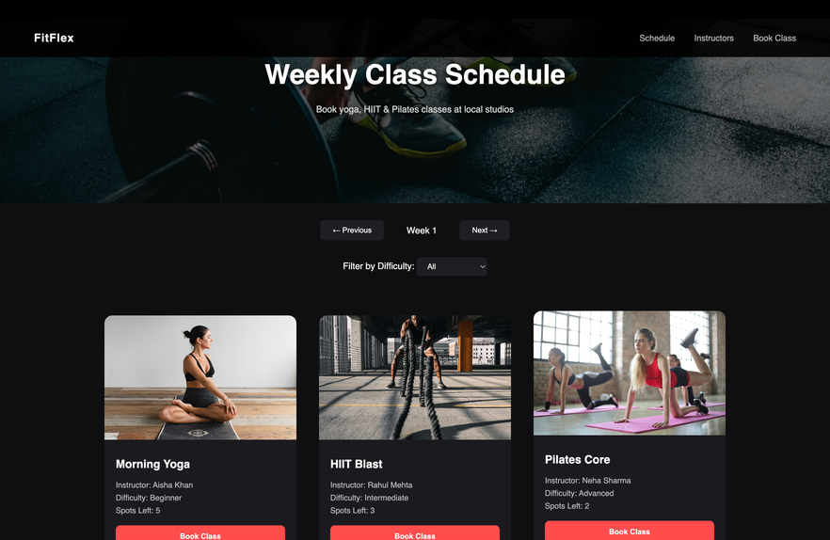
Solution
FitFlex – Gym Class Scheduler is a web application
developed using HTML, CSS, and JavaScript to
manage fitness class bookings.
Key Features:
• Weekly class schedule
• Difficulty based class filtering
• Class capacity tracking
• Instructor profile page
• Online booking form
• Discount calculation feature

Slide 5
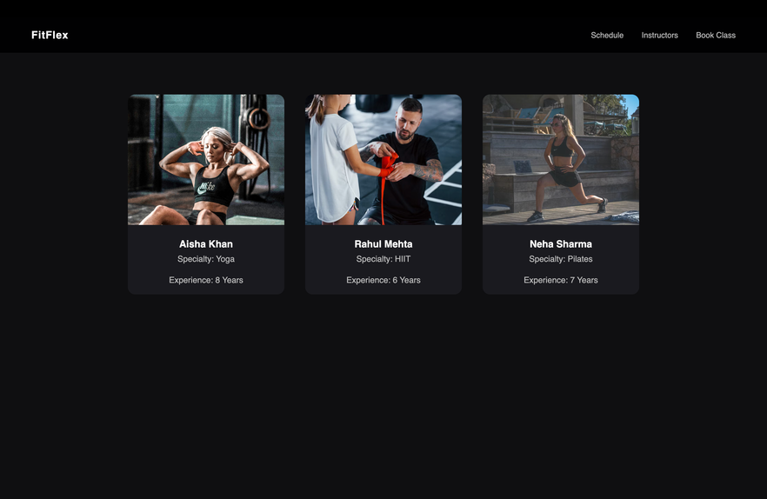
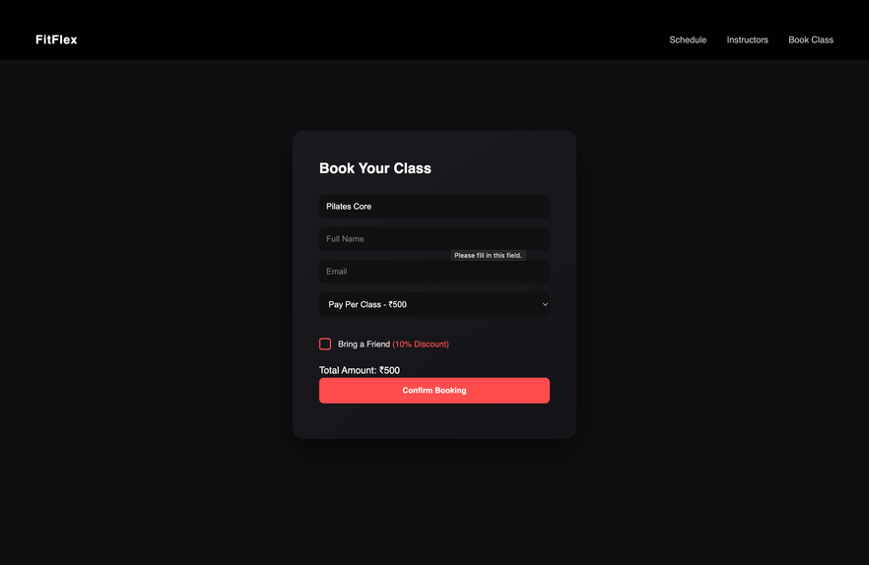
Working of the System
1. User opens the schedule page
2. User views available classes
3. User selects a class
4. User clicks "Book Class"
5. Selected class is stored using localStorage
6. User is redirected to booking page
7. User fills registration form and confirms booking
Technologies Used:
• HTML
• CSS
• JavaScript

Slide 6
Conclusion
The FitFlex Gym Class Scheduler successfully
demonstrates a functional front-end booking system.
The application allows users to:
• View schedules
• Filter classes
• Track available spots
• Register for fitness sessions
This project shows how HTML, CSS, and JavaScript
can be used to create interactive web applications.

Slide 7
Thank You

